Slide 1
ECONOMICS
[Type here]
[Type here]
[Type here]

Slide 2
Definition
Economics is the study of how people make choices to satisfy their wants.
Economics is the study of the management of wealth of nations.
Economics is the science which studies human behaviour as a relationship between ends and scarce means which have alternative uses, defined by Lionel Robins

Slide 3
Science and Scarcity
Economics is a social science because
1 it makes use of the methods used in the other physical sciences.
2 it employs all the scientific methodology to build its models and theories.
3 it follows scientific procedures like: stating of hypothesis, collection of data to tests the hypothesis by employing efficient methodology.
Scarcity
¹ Scarcity exists because resources are limited in supply and therefore individuals or communities have to choose among the limited resources.
2 The need for individuals/communities to make choices as a result of scarcity.
3 Scarcity is the most basic concept in the study of economics.
4 Scarcity differs from shortages or poverty.
[Type here]
[Type here]
[Type here]

Slide 4
Microeconomics Vrs Macroeconomics
Microeconomics is the study of decision making undertaken by individuals (or households) and by firms.
It involves studying of demand and supply of particular firms or industries, a trade union action for salary increment etc.
Macroeconomics is the part of economic analysis that studies the behaviour of the economy taken as a whole.
It therefore deals with economy-wide problems like the general price changes, unemployment, national income, etc.

Slide 5
Resources
Positive economics are analysis strictly limited to making either purely descriptive statements or scientific predictions.
Examples: An increase in the price of fuel will lead to an increase in prices of commodities. On average, countries in Sub-Sahara Africa have higher inflationary rate than those in Europe.
Normative economics are analysis involving value judgments about economic policies. This is a statement of what ought to be or what some people think it should be.
Examples: National debt ought to reduce since government have reduced expenditure. Ghana must be self sufficient in food since the country is endowed with abundant fertile land

Slide 6
Resources
Resources are inputs used in producing goods and services. They are
LAND: it includes all gifts of nature such as, water, fish, Gold, timber, etc. any natural resource is referred to us as land. Reward of land is rent
LABOUR: this involves mental and physical activities of human beings to help in production. The reward for labour is wages
CAPITAL: this involves all manufactured resources, including buildings, machines, equipments and improvement to land that is used in production. The reward for capital is interest.
ENTREPRENEUR: This involves human resources that performs the function of raising capital, and organizing the other factors of production to produce. Reward is profit.

Slide 7
Opportunity Cost
Opportunity cost is the highest-valued next best alternative that must be sacrificed to attain something or to satisfy a want.
Examples: Opportunity cost of studying one hour deep into the night during examination week is a loss of one hour sleep. Opportunity cost of dedicating one’s time to his/her lover is the loss of time for studying/working.
To know individuals opportunity cost, his scale of preference must be known.
Scale of preference is a table that shows individuals wants arranged orderly with the most pressing wants put first on the table.

Slide 8
Production Possibility Curve (PPC)
A curve representing all possible combinations of inputs that can be used to produce a specific level of output is called PPF. Assumptions underlying the PPF are:
The economy produces only two commodities. Resources are fully employed.
Production is done over a specific time period (say a year) Labour force remains the same and that skills remain the same. Capital inputs remain the same.
Technology does not change under the time under consideration.

Slide 9
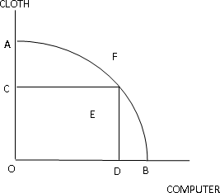
PPC/PPF cont’d
Figure 1: Graph of Production Possibility Frontier

Slide 10
Economic systems
Economic system is a set of institutions or social framework in which scarce resource are, managed to produce goods and services to satisfy human wants or society wants. There are three main types of economic systems and they are:
Capitalist economic system: with this type of economic system goods and services are provided by private individuals and firms independent of government control. Example USA
Socialist economic system: with this type of economic system, majority of goods and services are provided by the state. Example Cuba
this system contains a mixture of both market and socialist system. Actually there is no economy which is purely capitalist or purely socialist but we look at the extent which the economy is mixed and
make some capitalist and some socialist

Slide 11
Functions of Economic systems
What to produce: The basic problem of an economic system is to determine what commodities the scarce resources should be use to produce. In the capitalist system, what to produce is determined by demand and supply. For the socialist, it is determined by the state.
How to produce: owing to scarcity of resources, the economic system must choose the best method of production in order to minimize cost and maximize output. Prudent to choose whether to use capital or labour intensive method.
How much to produce: Owing to scarcity of resources, the economic system decides on how much of each product should be produce. Whether to produce more capital good or consumer good.
For whom to produce: The economic system decide on whether to use the scarce resources to build more schools or construct entertainment centers. Goods and services produced are distributed
through the market using price in Capitalist.

Slide 12
Difference between capitalist and Socialist
Ownership of resources: Individual owns resources in the capitalist economy and they decide on what to do with them. The state owns resources in the socialist economy.
Allocation of resources: in the capitalist system, market prices determine who will get each commodity that is being produced. In the socialist economy,the centrally planning committee determines allocation.
Determination of prices: in the capitalist system, prices are
determined by the forces of demand and supply. In socialist economy, prices are fixed and determined by a planning authority formed by the state.
Consumers sovereignty: Greater degree of consumers freedom under the capitalist than under the socialist system. increase in demand increase price, supply therefore increases.
Income inequality: Incomes tend to be more inequitably distributed in
the capitalist economy than in the socialist economy. Under capitalism, production is done for the rich who can afford.

Slide 13
Price Mechanisms
Price mechanism is a situation where demand and supply freely interact to determine prices. The mechanism ensures that at any period equilibrium is restored.
Demand is the quantity of goods and services that consumers are willing and able to buy at a particular price and at a particular period of time.
The law of demand states that all things being equal, the higher the price the lower the quantity demanded and the lower the price the higher the quantity demanded.
Individual demand commodities and when we sum all individual demand horizontally given price we call it market demand. E.g. consider the table below
[Type here]
[Type here]
[Type here]

Slide 14
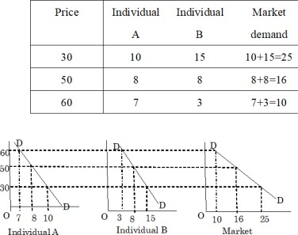
Table and Graph of demand
Figure 2: Demand Schedule and Demand Curve

Slide 15
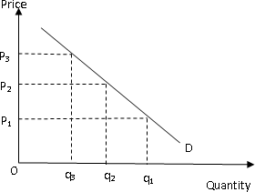
Movement along the demand curve
Figure 3: Demand Curve

Slide 16
Determinants of demand
The own price of the good The price of substitute goods
The price of complementary goods
The level of advertising expenditure on the product in question as well as advertising made by company producing related products
The level of income
Consumers tastes and preferences Cost and availability of credit
Consumers expectations concerning future price rises and product availability
Changes in population

Slide 17
A change in demand Vrs a change quantity demanded
A change in quantity demanded is a price induced change, such
change is brought about by changes in price.
When price rise quantity demanded fall and when price fall, quantity demanded increase as can be seen from the graph below
see graph above for a change in quantity demanded
A change in demand is an autonomous change. It occurs when the other determinants of demand changes but the actual price of the product remains the same. It involves a shift of the demand curve to the right or left. graph below for a change in quantity demanded

Slide 18
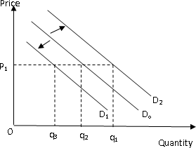
A change in demand
Figure 4: Shift of a demand curve

Slide 19
Exceptional demand curves
The normal demand curve slope from left to right and any demand curve which does not slope from left to right is an exceptional demand curve. (Sketch all the exceptional demand curves to students)
Upward sloping demand curve (typical of giffen goods)
Backward bending demand curve (typical of prestigious or luxurious commodities)
Perfectly elastic demand curve
Perfectly inelastic demand curve (demand for salt/ drinking water)

Slide 20
Supply
Supply is the quantity of goods and services producers re willing to offer for sale at a particular price at a particular point in time.
Individual supply an output and a group of individuals can supply the same output.
The horizontal summation of individual supply at a given price is called market supply. Below is a table and curve showing individual and market supply.
The law of supply state that all things being equal the higher the price the higher the quantity supplied and the lower the price the lower the quantity supplied.
see demand curve and demand schedule in the next slide

Slide 21
Supply
Supply is the quantity of goods and services producers re willing to offer for sale at a particular price at a particular point in time.
Individual supply an output and a group of individuals can supply the same output.
The horizontal summation of individual supply at a given price is called market supply. Below is a table and curve showing individual and market supply.
The law of supply state that all things being equal the higher the price the higher the quantity supplied and the lower the price the lower the quantity supplied.
see demand curve and demand schedule in the next slide

Slide 22
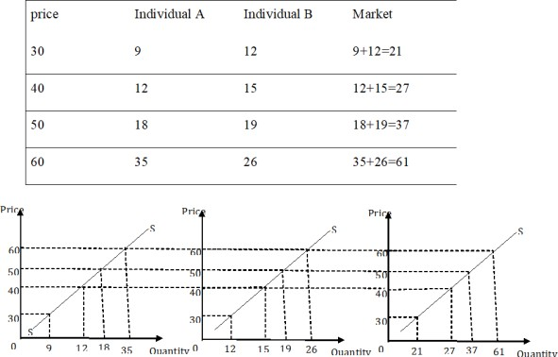
Supply Curve and Supply Schedule
Figure 5: Supply Schedule and curve

Slide 23
Determinant of Supply
The price of the commodity in question Changes in cost of production
Prices of related products (i.e. competitively produced goods and joint supply)
Changes in profit
Climate (natural phenomena)

Slide 24
A change in supply and a change in quantity supplied
A change in quantity supply is the movement along the same supply
curve. The change in quantity supply could be contraction or expansion.
A contraction supply occurs when prices decrease and vice versa (Find graph in the next slide)
A change in supply occurs when the supply curve either shift to the right or to the left.
This occurs when the other factors determining supply change other than the price of the commodity itself. (check graph below)

Slide 25
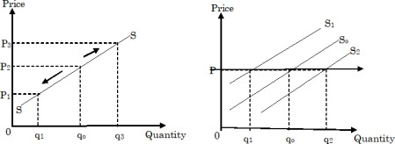
Supply Curve and Supply Schedule
Figure 6: Supply Schedule and curve

Slide 26
Exceptional Supply Curve
A perfectly elastic supply Curve A perfectly inelastic supply curve Backward bending supply curve

Slide 27
Equilibrium
Equilibrium is define as a point from which there tends to be no movement unless demand and supply changes.
Any movement away from this point will set into motion certain forces that will cause movement back to it. Therefore equilibrium is a stable point.
Equilibrium point occurs where supply and demand curve intersect. Equilibrium price is given on the vertical axis directly to the left where supply and demand intersect.
The equilibrium quantity demanded and supply is directly given underneath the intersection of demand and supply curves.

Slide 28
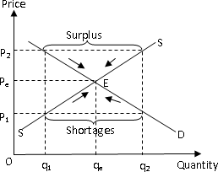
Equilibrium
Figure 7: Interaction between demand and supply

Slide 29
Mathematical example
Suppose the demand and supply for rice is respectively given as 5P+q=800 and 10P-q=700. Find
¹ The equilibrium price and quantity of rice
2 If the price is set at P=80, find quantity demanded and quantity supplied.
3 Briefly explain the effect of fixing the price at P=80

Slide 30
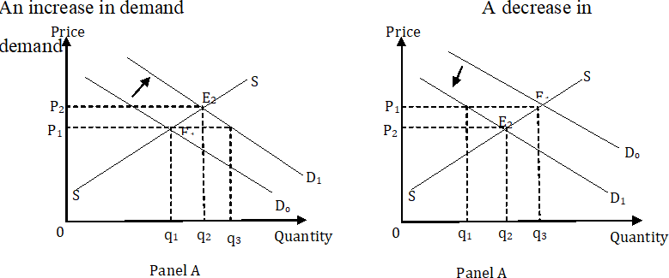
Changing demand and supply in equilibrium
Figure 8: A change in demand

Slide 31
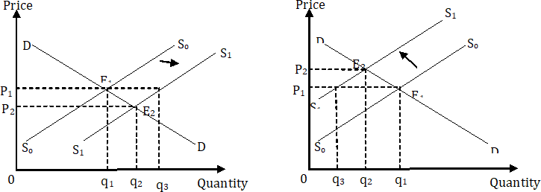
Changing demand and supply in equilibrium
Figure 9: A change in supply

Slide 32
Price Control
Price control is a legal price at which a market is traded (i.e. sold and bought). Price control is in the form of maximum price control and minimum price control
1 Maximum price control (price ceiling)
The maximum price is the highest legal price at which a commodity must be bought or sold.
Maximum price control is set below the equilibrium price of the product. Maxim price control leads to shortages
Conditional sales: sellers would use the scarce commodity to sell other commodities which are not in demand.
Queuing device can be adopted where first come first served method would be use.
Rationing: commodities can be supplied to one area whilst the others wait for their turn. Using of coupons to distribute the scarce commodity
it is set to protect consumers(electricity and water).

Slide 33
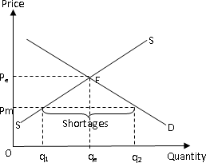
Price legislation
Figure 10: Maximum price control

Slide 34
Minimum price control
The minimum price control is the lowest legal price at which a commodity must be traded.
It is an offense to trade a commodity below that price.
Such a price is fixed above the market equilibrium price. Thus, at that price surpluses would be created in the market.
To maintain a stable price above the equilibrium, the surplus market must be cleared, i.e. operating a buffer stock.
1 The government buys the surplus and store them and later releases them for sale when there is shortages
2 The government buys the surplus and exports them.
Maximum price legislation is set to protect producers, especially producers who produces essential commodities but with low prices (e.g. agricultural products).

Slide 35
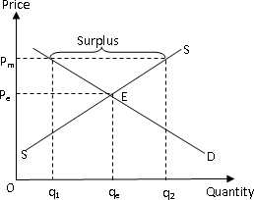
Price legislation
Figure 11: Minimum price control

Slide 36
Advantages and Disadvantages
Advantages of price mechanism
1 Consumers sovereignty
2 Resources are allocated without cost to society
³ Variety of goods
⁴ Lower prices
Disadvantages
 | 1 | The needs of the poor tend to be ignored
 | 2 | Income distribution become more and more unequal
 | 3 | Private benefits are promoted at the expense of social benefits
 | 4 | Not suitable for the production of public goods
 | 5 | Instability of prices.

Slide 37
Price elasticity of demand
Price elasticity of demand (Ep) is the responsiveness of quantity demanded of a commodity to changes in its price.
It is define as
Thepercentagechangeinquantitydemand Thepercentagechangeinpriceofthegood
Example: Suppose quantity of a commodity changes by 1% when
price change by 10%, then ϵp = ^{1%} = 0.1
10%
An elasticity of 0.1 means that as price changes by 1%, quantity also change by 0.1%.
For inferior, normal and superior goods, price elasticity is negative but for giffen the price elasticity is positive

Slide 38
Price elasticity of demand cont’d
We often ignore the negative sign in economics analysis Mathematically price elasticity of demand is expressed
∆Q P ϵp = _{∆P} X _{Q}
where
∆Q is change in quantity demanded, ∆P is change in price, P is price of the commodity, and Q is the quantity demanded of the commodity
Another method use to calculate elasticity of demand uses average values of the two prices and quantities. This formula is referred to as arc elasticity of demand and is given as
₌ ∆Q _{X} P1 + P2
ϵ
p
∆P
Q1 + Q2

Slide 39
Price elasticity of Example
Example: As price falls from GH100 to GH75, quantity demanded of Maize rises from 50000 tonnes to 55000. Calculate
1 Point elasticity of demand
2 arc price elasticity of demand
Note: solve the example on the board
[Type here]
[Type here]
[Type here]

Slide 40
Price elasticity ranges
¹ Elastic demand: A good has an elastic demand whenever the price elasticity of demand is greater than one but not infinity. That is, a one percentage change in prices causes a response greater than one percent change in quantity. Thus ϵp > 1
2 Unit elastic demand: A one percent change in price causes a response
of an exactly one percent change in quantity demanded. ϵp = 1
3 Inelastic demand: A one percentage change in price causes a response
less than one percent change in quantity demanded. ϵp < 1
⁴ Perfectly elastic demand: A one percent changes in price causes a
response of an infinite change in quantity. ϵ ∞=
5 Perfectly inelastic demand: a one percent change in price causes no
change in quantity demanded. ϵp = 0

Slide 41
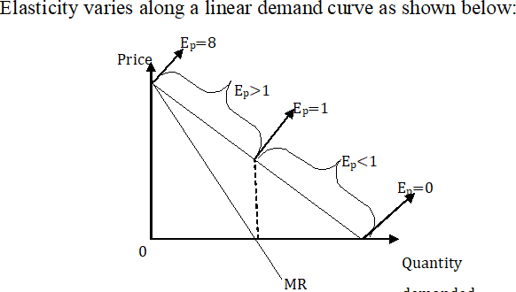
Elasticity and the linear demand curve
Figure 12: Elasticity and demand curve

Slide 42
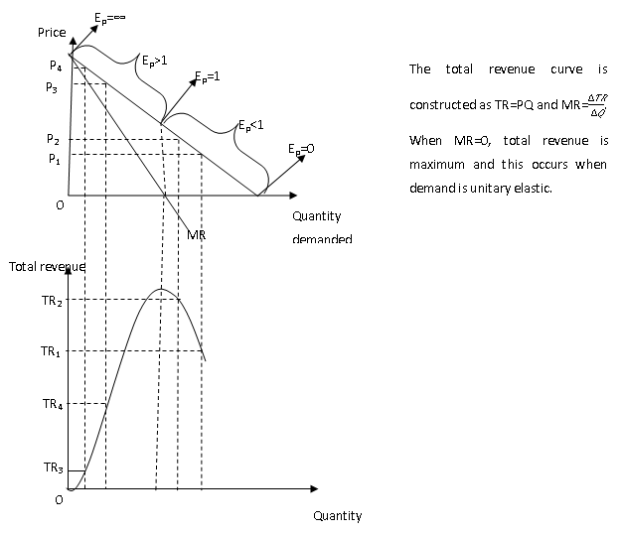
Elasticity and the total revenue curve
Figure 13: Elasticity and Revenue curve

Slide 43
Determinants and Importance of price elasticity of demand
Determinants of price elasticity of demand
1 Availability of substitutes
2 Degree of necessity
3 Habit
4 The size of the consumers income
5 The size of the consumers income spent on the good (share of the budget)
Importance if elasticity of price elasticity of demand
1 Pricing policy
2 Taxation

Slide 44
Cross Price elasticity of demand
Cross Price elasticity of demand
(ϵx y )istheresponsivenessofquantitydemandedofacommodityasaresultofasm
Mathematically it is expressed as
ϵ y = ^{∆Qx} X ^{Py}
x
∆Py Qx
or
_{ϵ y =} ∆Qx _{X} Py 1 + Py 2
x
∆Py Qx 1 + Qx 2
For inferior, normal and superior goods, price elasticity is negative but for giffen the price elasticity is positive
[Type here]
[Type here]
[Type here]

Slide 45
Cross elasticity cont’d
In cross elasticity of demand, the elasticity coefficient can be positive or negative.
When elasticity coefficient is positive (i.e.ϵx y > 0) then the two commodities are substitutes. When ϵx y < 0, then the two commodities are complements.
Example: Find the cross elasticity of demand when the demand of Milo increases from 80tins to 120 tins as a result of a price change of bournvita from GH6 to GH8.
today
45 / 101

Slide 46
Income elasticity of demand
Income elasticity of demand (ϵy ) is the responsiveness of quantity demanded of a commodity as a result of a small proportionate change
in the income of the consumer.
It is define as
Thepercentagechangeinquantitydemandedofagood Thepercentagechangeinincomeoftheconsumer
Mathematically it is expressed as
∆Q Y ϵy = _{∆Y} X _{Q}
or
₌ ∆Q _{X} Y1 + Y2
∆Y Q1 + Q2
ϵ
y

Slide 47
Income elasticity cont’d
In income elasticity of demand, the elasticity coefficient can be positive or negative.
When elasticity coefficient is positive (i.e.ϵy > 0) then the commodity is either inferior, normal or luxury. When ϵy < 0, then the commodity are giffen.
Example: Suppose a consumers monthly income increases from GH1500 to GH1800 as a result of an end of year salary review. If before the increase, he was demanding 25kg of a particular good, but his demand fell to 20kg after his income has increased. Calculate the income elasticity of demand and determine the nature if the product to the consumer.

Slide 48
Price elasticity of supply
Price elasticity of supply (ϵs ) is the responsiveness of quantity supplied of a commodity to changes in its price.
It is define as
Thepercentagechangeinquantitysupplied Thepercentagechangeinpriceofthegood
Mathematically price elasticity of demand is expressed
∆Q P ϵp = _{∆P} X _{Q}
or
_{ϵ =} ∆Q _{X} P1 + P2
p
∆P Q1 + Q2
where
∆Q is change in quantity demanded, ∆P is change in price, P is price of the commodity, and Q is the quantity supplied of the commodity

Slide 49
Determinants of price elasticity of supply
Length of time adjustment Availability of inputs Technology
The number of markets Weather (climatic conditions)

Slide 50
Background to Consumer behaviour
When price of commodity increases, demand of the commodity falls because marginal consumers leave the market and existing consumers reduce the amount they buy.
When price falls, consumers who could not buy at the earlier higher price join the market and existing consumers increase the amount they buy causing total demand of the commodity to increase.
This attitude of consumer demand to price changes is explained by the law of marginal utility.
Two approaches would be use to determine consumer behaviour when commodity price changes.

Slide 51
Marginal Utility Approach
Assumptions
1 The consumer is assumed to be rational
2 Prices of goods are determined by the free interaction of demand and supply
³ Marginal utility of money is assumed to be constant
The law of marginal utility states that, other things being equal, as more and more of a commodity is consumed, the total utility may be increased but the marginal utility reduces.

Slide 52
Basic Utility terms and formulas
Total Utility: this is the total satisfaction an individual gets from consuming a quantity of a commodity. The unit of measurement is utils. Total_{Σ} utility is obtained by summing up the marginal utilities, i.e. TU = MU.
Marginal utility: This is the additional satisfaction derived from
consuming one extra unit of a commodity. MU = ^{∆TU} , where ∆TU
∆Q
is change in total utility and ∆Q is change in quantity.
Average utility: this is the total utility per unit of the quantity of the
commodity consumed. AU = ^{TU}
Q
Satiation point: This is the point where total utility is at its maximum and marginal utility is zero.

Slide 53
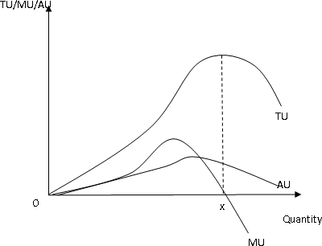
Graph of TU, AU and MU
Figure 14: Minimum price control

Slide 54
Consumer Equilibrium(Single Commodity)
Equilibrium of the consumer occurs when MU of the commodity he consumes is equal to the price he pays for the good. i.e. MUx = Px
where MUx is marginal utility of x and Px is price of x.
When price of the commodity is increased, then MUx < Px and therefore disequilibrium occurs.
To restore equilibrium, MU must increase and this is only possible when the consumer reduces the quantity of the commodity that he consumes.
The consumer will continue to cut the amount of the commodity he consume till MUx = Px
when price falls, MUx > Px and consumer have to increase the quantity of the commodity he consumes till MUx = Px .
The MU curve of a commodity is the same as the demand curve.

Slide 55
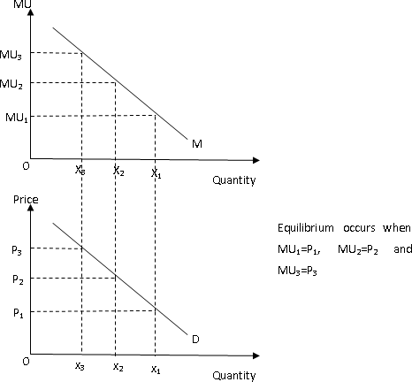
Utility and Demand curve
Figure 15: Relationship between MU and demand curve

Slide 56
Consumer Equilibrium(Two Commodities)
For two or more commodities, the consumer is in equilibrium when marginal utility per price of the commodities are all equal.
Consider commodities X and Y, then equilibrium is ^{MUX} = ^{MUY}
P_{X} PY
A rise in price of X will make ^{MUX} < ^{MUY}
P_{X} P_{Y}
To restore the equilibrium, MUX must rise and this is only possible when quantity of X consumed is being reduced.
Similarly, when price of x falls ^{MUX} < ^{MUY} and to restore equilibrium
PX PY
MUX must also fall and this can only occur when quantity of commodity that is being consumed is increased.

Slide 57
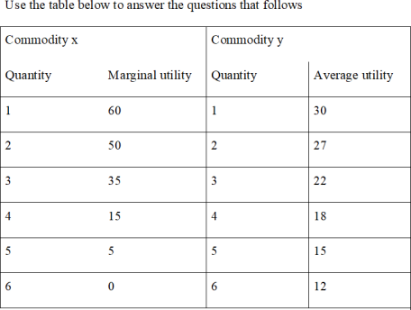
Utility example
Figure 16: Example

Slide 58
Utility example cont’d
1 Calculate TU of commodity X and commodity Y
² Calculate MU of commodity Y
³ Which of the commodities would he pay higher price when 4 units are consumed?
⁴ Suppose the price of X is 5 and that of Y is 4. How many of the quantity of X and Y should be consumed in order for the consumer to be in equilibrium.
5 If price of X increase to 10 whiles that of Y remains the same, explain how the equilibrium conditions will behave.
⁶ Use your results to draw a demand curve.
Discuss the example in class

Slide 59
The Paradox of Value
Marginal utility helps us to understand why some goods which are necessity (e.g. water) cost less in the market than luxuries such as diamonds.
The marginal utility of the first unit of water consumed will be very high but we consume lots of water.
Utility of the last unit of water consumed is relatively low. By contrast, diamonds are scarce and the marginal utility from consumption tends to be very high.
The outcome is that water is sold at a lower price than diamonds.
Utility theory explains the apparent paradox that some necessities are priced lower than luxuries. This example is refereed to as the paradox
of value.

Slide 60
Time Periods in Production
Production is the creation of goods to satisfy human wants.
The factors of production of any country are resources such as land, labour, capital and entrepreneur.
The quantity and quality of the factors determines the volume and quality of goods and services produced.
There are three time periods in production, they are
1 Market time period: this time period is so short that the supply of goods and services is limited to the quantities already in the market
.All factors of production are fixed.
2 The short-run time period: is the time period so short that at least one input is fixed. Output can only be increase by employing more variable inputs. Fixed factors can also be used intensively.
3 The long-run time period: In this time period, all inputs are variable.

Slide 61
Production analysis in the short run
Fixed input: these are inputs whose quantity cannot be changed in the short-run. Examples are machinery equipments, factory building, management, etc.
Variable input: these are inputs whose quantity varies with output. Examples are raw materials, labour, etc.
the law of diminishing marginal returns states that, all things being equal, as more and more of variable factor are employed on a fixed input, the addition to the total product initially increased, attains a maximum and thereafter diminishes.
Assumptions
1 There are two inputs, i.e. fixed and variable inputs
2 All units of variable inputs are equally efficient.
3 The level of technology is constant.

Slide 62
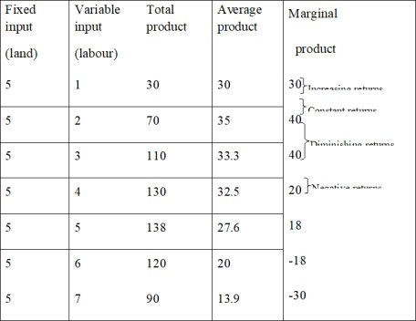
Diminishing Marginal Returns illustration
Figure 17: Returns

Slide 63
Marginal and Average Input
MP is the addition to total product as a result of employing one more unit of the variable product as a result of reducing variable input by one unit.
MP = ^{δQ}
δV
where ∆Q is change in quantity and ∆V is change in variable input.
From the table,
_{MP4 =} TP4 − TP3 ₌ 130 − 110
= 20
V − V 4 − 3
4 3
Average product (AP) is the total product per unit of the variable
input. AP = ^{TP} = ^{Q}
V V
From the table, AP4 = ¹³⁰ = 32.5
4
Σ
Total product (TP) is the sum of MP. (i.e.TP = MP).
From the table TP4=3=+40+40+20=130

Slide 64
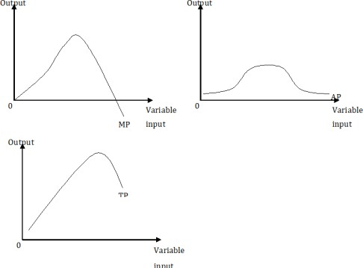
Graph of MP and AP
Figure 18: Returns

Slide 65
Marginal and Average Input
Increasing returns: there is increasing returns where MP of the variable input rises. The variable inputs at this stage are combined in their most economical proportion with the fixed input hence MP rises.
Constant returns: there is constant returns when addition to TP remains the same. The best combination of the variable input and fixed input has been attained.
Diminishing returns: there is diminishing return when marginal product of the variable input falls. The variable input and the fixed input are combined in their uneconomical proportion. Negative returns: additional variable input subtract from total product.

Slide 66
Stages in production
Stage I
This is the stage of rising average product.
When average product is rising it lies below the marginal product.
When AP is rising, by implication the MP of the fixed input is negative.
At this stage too much of the fixed input is combined with the variable input.
If a firm is in a competitive industry it would never produce in stage I because by expanding output it can reduce unit cost, While receiving the same price for each additional unit sold.

Slide 67
Stages
At this stage, AP is falling but marginal product is positive. At this stage the fix input and the variable inputs have been combined in their most economical proportion.
Efficient production occurs at this stag

Slide 68
Stages 68
This corresponds to the usage of variable input where MP is negative.
At this stage too much of the variable input is combined with the fixed input.
The MP of the variable input is negative. More output can therefore be realized by using less of the variable input.

Slide 69
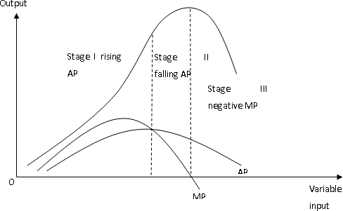
Graph of the three stages
Figure 19: Returns

Slide 70
Relationship between MP & TP, MP & AP
Relationship between MP and TP
1 When MP is rising, TP rises at an increasing rate
2 When MP is falling but greater than zero, TP rises but at a decreasing rate.
³ When MP is zero, TP is maximum
4 When MP is negative, TP is falling
Relationship between MP and AP
¹ When MP is greater than AP, AP rises
2 When MP is less than AP, AP falls
3 MP is equal to AP when AP is maximum.

